Slide 1
Summarizing Highly Structured Documents for Effective Search Interaction
Date : 2013/1/10
Author : Lanbo Zhang, Yi Zhang, Yunfei Chen
Source : SIGIR’12 Speaker : Wei Chang
Advisor : Dr. Jia-ling Koh

Slide 2
OutLine
Introduction
Approach
Experiment
Conclusion

Slide 3
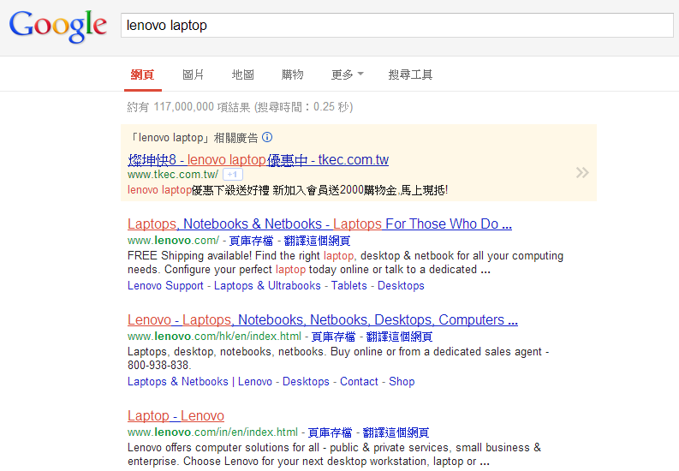
Summaries of Search Result
Summaries

Slide 4
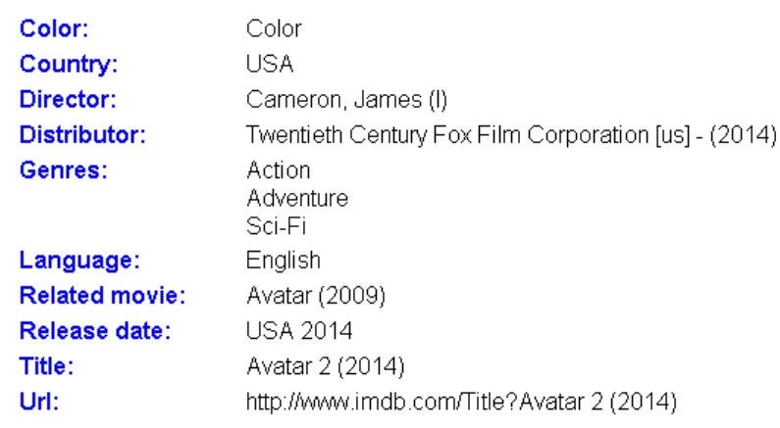
Highly Structured Document
Facet
Value
Pair

Slide 5
Summaries for Highly Structured Documents

Slide 6
2 Exists Approaches
Manual Facet Selection
Query-biased methods
– Used for summarizing unstructured documents (Google, Yahoo, Bing, etc.)
– Show FVP containing query terms

Slide 7
Goal
Problem
Some important facet value pairs without query terms might never be shown
Query: 15-inch silver laptop by Lenovo
FVP: color: black
Some important facet value pairs without query terms might never be shown
Query: 15-inch silver laptop by Lenovo
FVP: color: black

Slide 8
OutLine
Introduction
Approach
Experiment
Conclusion

Slide 9
Approach
Rank Facet Value Pairs
Rank Facets
Summarization search Results

Slide 10
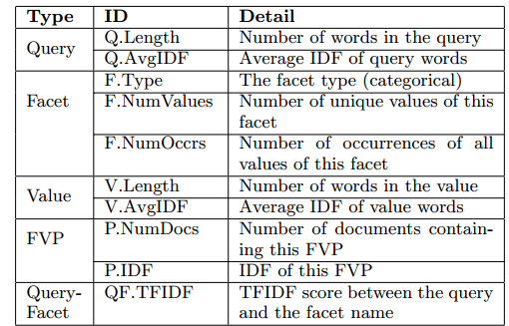
Features between ranking facet-value pairs(1)

Slide 11
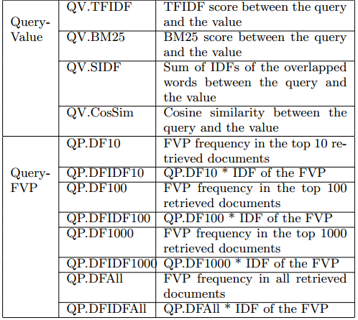
Features between ranking facet-value pairs(2)

Slide 12
Classifier
• Gradient Boosted Trees

Slide 13
Approach
Rank Facet Value Pairs
Rank Facets
Summarization search Results

Slide 14
Rank Facets

Slide 15
Approach
Rank Facet Value Pairs
Rank Facets
Summarization search Results

Slide 16
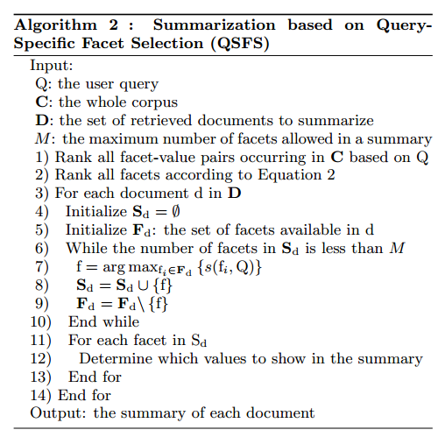
QSFS

Slide 17
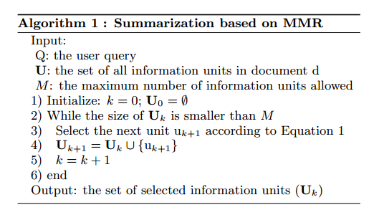
MMR For Unstructured Documents
sentence

Slide 18
MMR For Faceted Documents
v(fi,d) = all the values of facet fi in document d, which are
treated as a single sentence when calculating the similarities.

Slide 19
QSFS+MMR

Slide 20
OutLine
Introduction
Approach
Experiment
Conclusion

Slide 21
A Utility-Based Evaluation Framework
3 Assumptions:
We assume a user will read every document summary in the result list.
We assume a user can recognize the relevant document after clicking on and accessing the full document.
we assume a user will click on a document if the user guesses the document is relevant (+) based on the summary

Slide 22
Evaluation Metrics
= the set of all queries
= a query
= the set of all queries

Slide 23
Mean Average Normalized Utility (MANU)

Slide 24
Data Set
From IMDB
1,594,513 movies
26 query topics
Relevance judgments of query-document

Slide 25
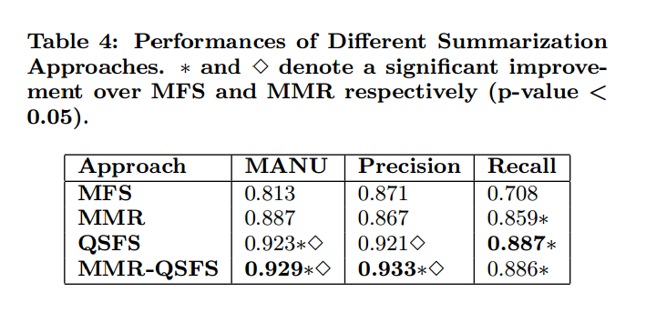
Summarization Approaches

Slide 26
Outline
Introduction
Approach
Experiment
Conclusion

Slide 27
Conclusion
In the future, we will explore how user interactions can be used to train the model so that the summarization approach can directly optimize the utility measure (i.e. MANU).

